Slide 1
Artificial Intelligence Boosting w/out Code
Self-Service AI & Deep Learning

Slide 2
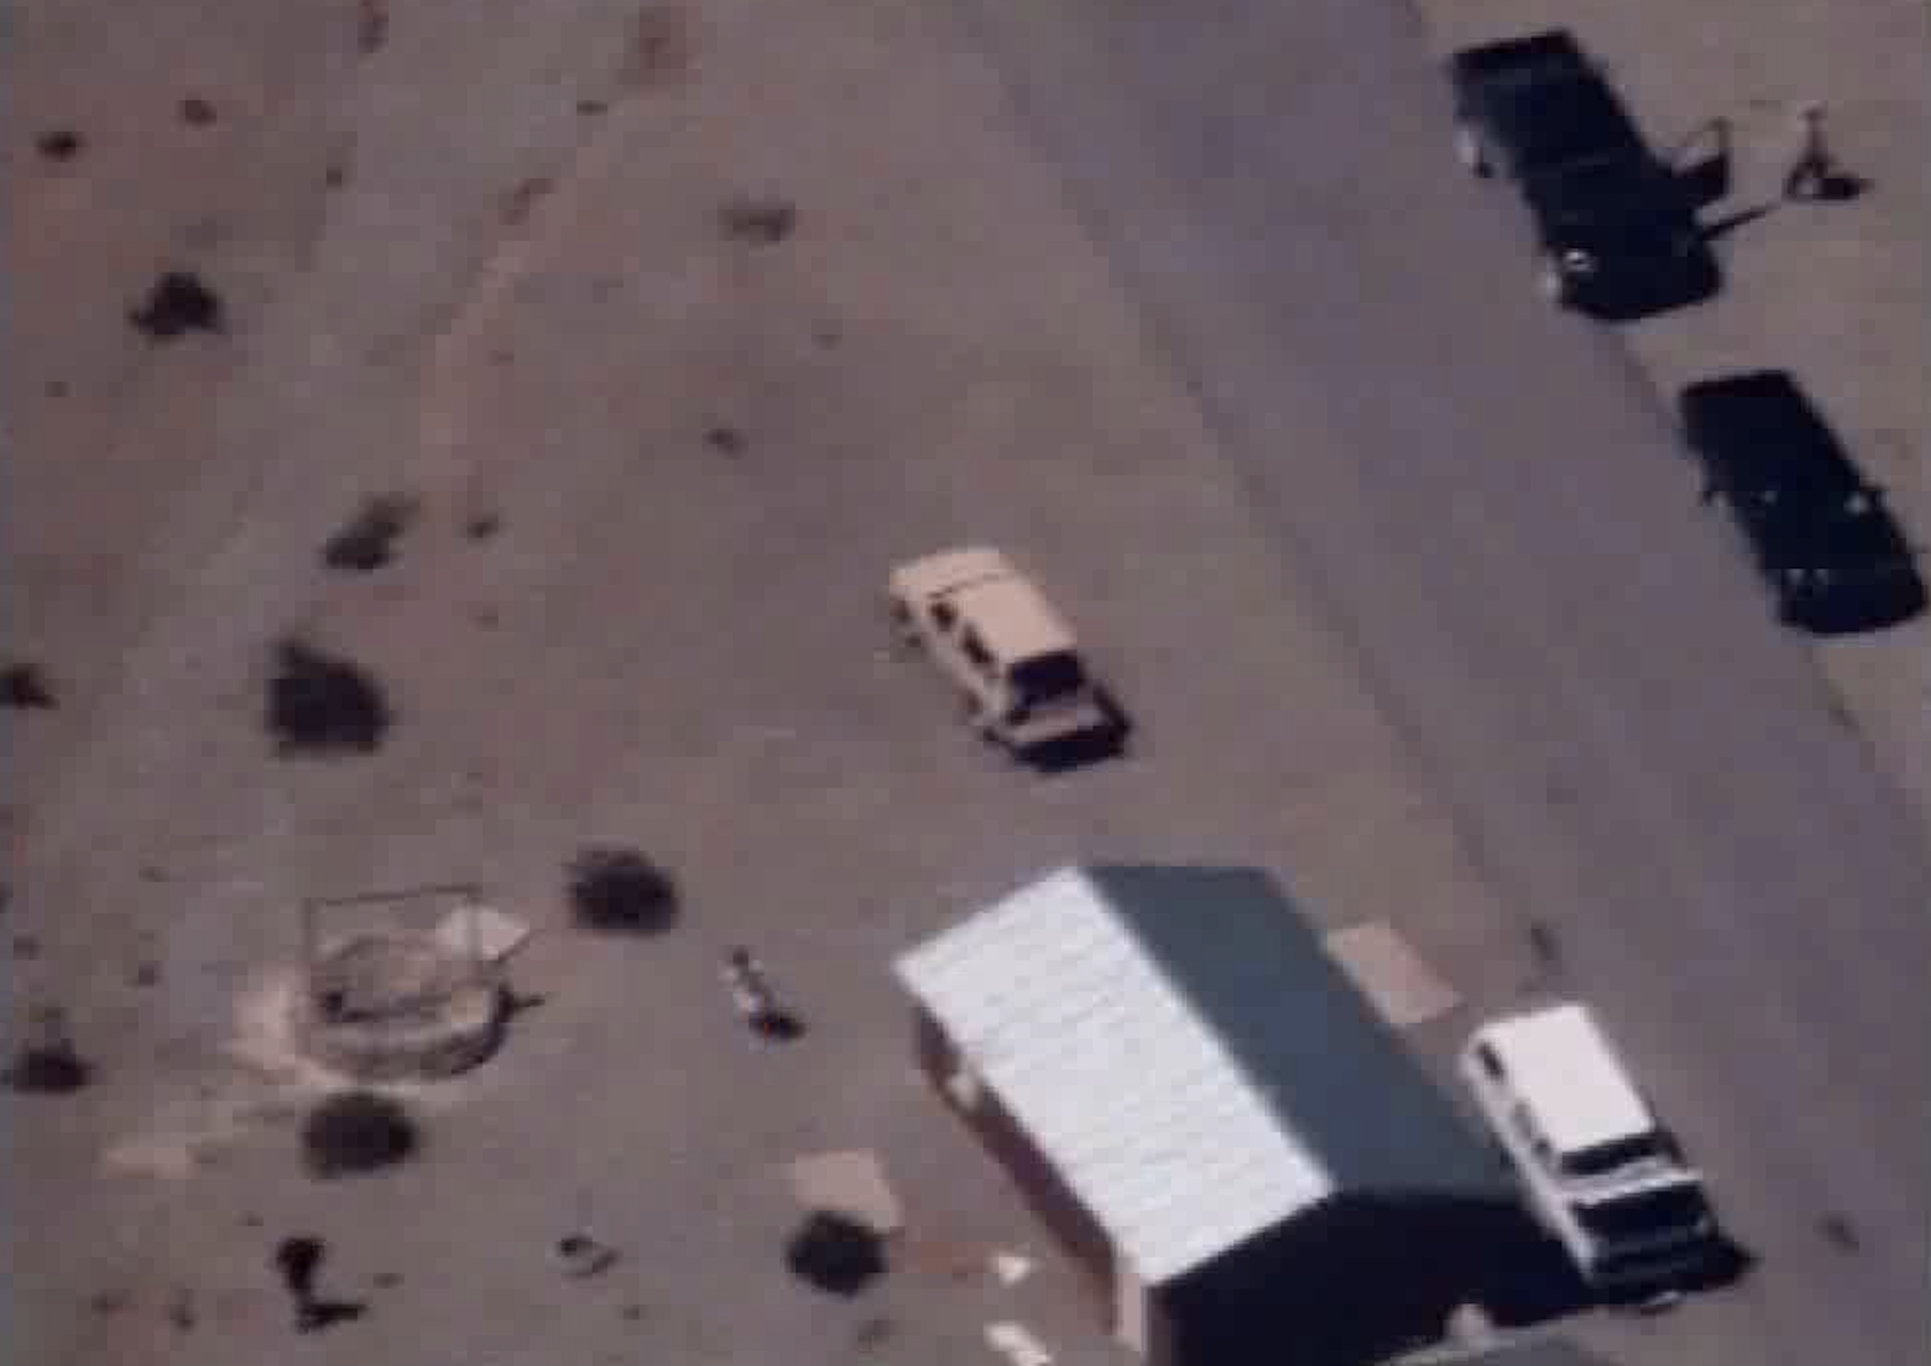

Slide 4
false positive

Slide 5
false positive
false negative

Slide 6
false positive
true positive
false negative

Slide 7
false positive
true negative
true positive
false negative

Slide 8
false positive
true negative
How do we fix these?
true positive
false negative

Slide 9
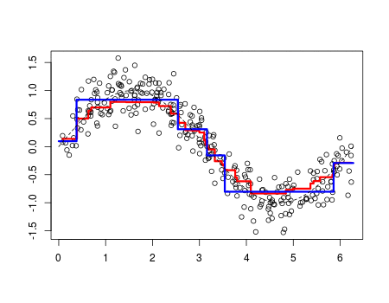
Boosting
“update weights of incorrectly classified images”

Slide 10
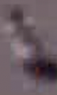
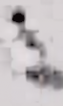


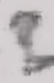
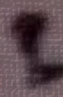


Boosting
person
not person

Slide 11
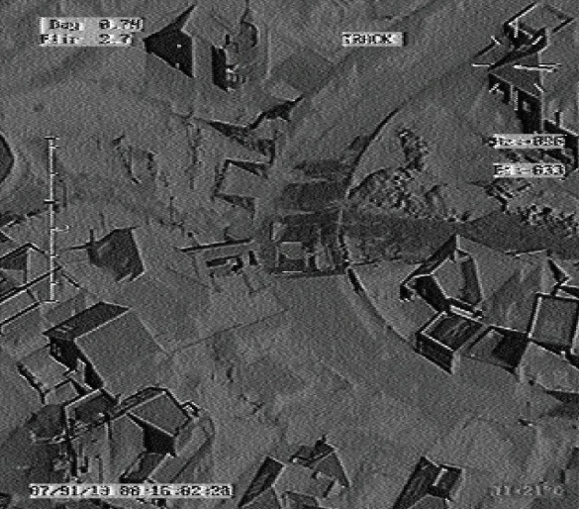
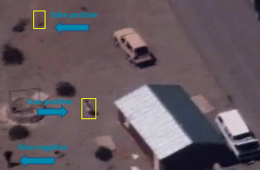
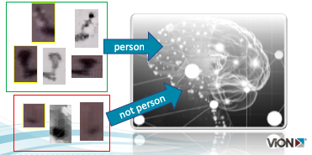
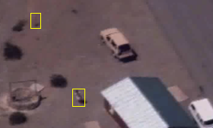
DevOps Cycle
production
test
Induce algorithm / train
inference

Slide 12
Customer Problems
GOTs solution w/no more support (company dissolved)
Boost accuracy, avoid re-certification
Improve performance (GPU optimize on OpenCV)
Easy Button

Slide 13
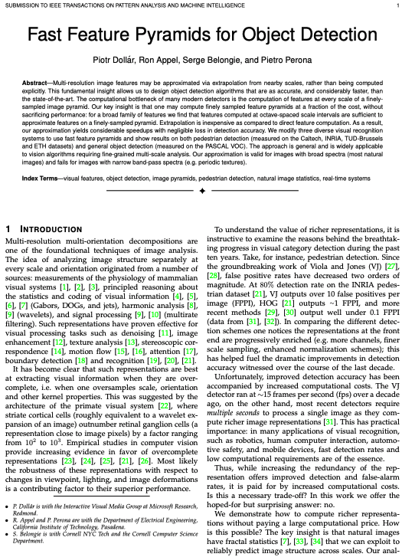
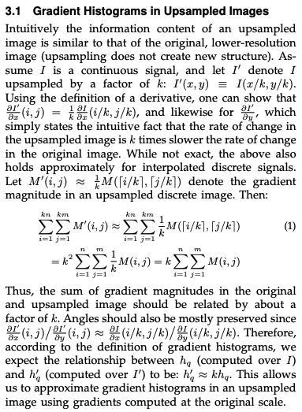
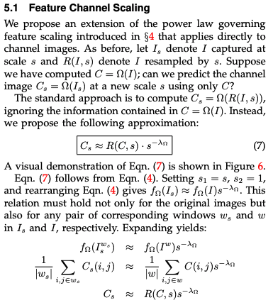
Object Detection w/ Fast Feature Pyramids

Slide 14

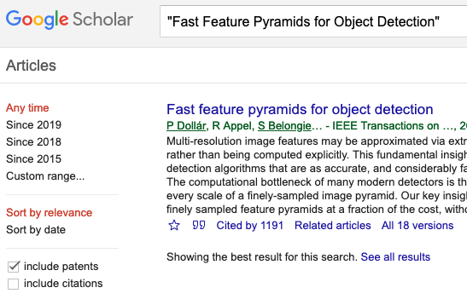
14 dense pages https://eeexplore.ieee.org/xpl
Cited 1191 times!!!

Slide 15
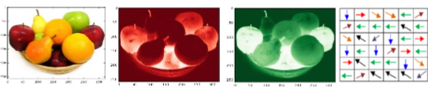
Pictographically Explained
image pyramids
aggregate feature channels (afc)
train adaboost tree ensemble
non-maximal suppression (nms)

Slide 16
What is a digital image?

Slide 17


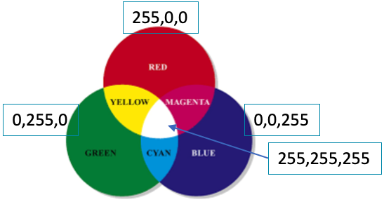

Matrix of Pixels
R:112
G:26
B:20
R:109
G:49
B:39
R:188
G:56
B:49
R:95
G:45
B:27
Matrix of pixels
Each pixel is typically 3 integers
Intensities of red, green, blue (rgb)

Slide 18
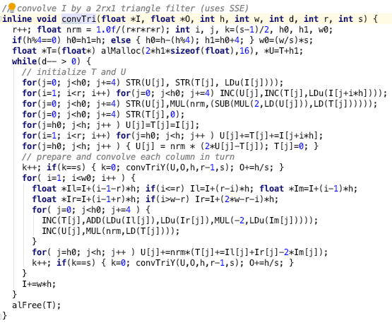
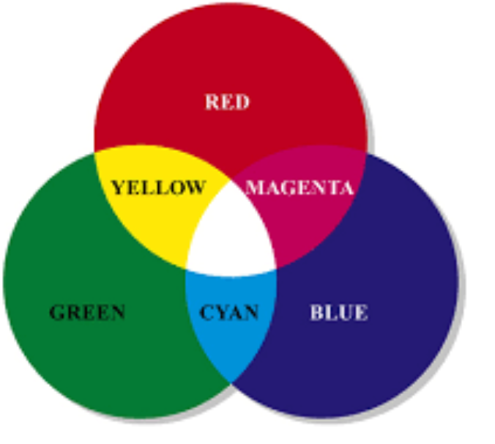
Channels Colors
So many for loops…
ripe for GPU optimization
red
green
blue
255,0,0
0,255,0
0,0,255
255,255,255

Slide 19
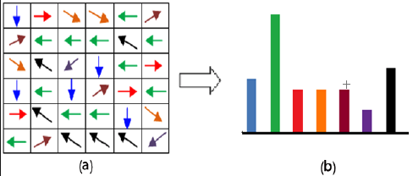
Channels Gradients
12 | 34 | 143 | 201 | 255
12 | 34 | 143 | 201 | 255
12 | 34 | 143 | 201 | 255
12 | 34 | 143 | 201 | 255
12 | 34 | 143 | 201 | 255
Gradient Direction/Orientation
As Histogram
Gradient Magnitude

Slide 20
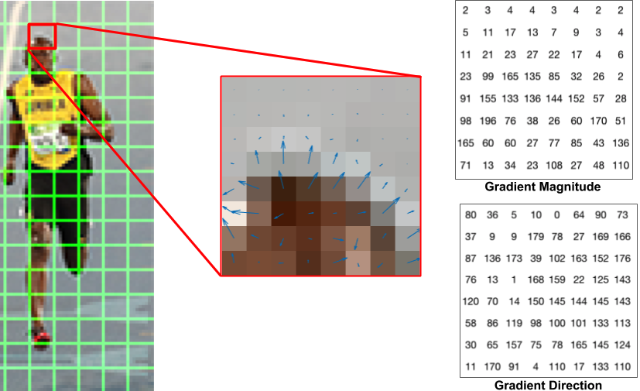
Another Gradient Explanation

Slide 21
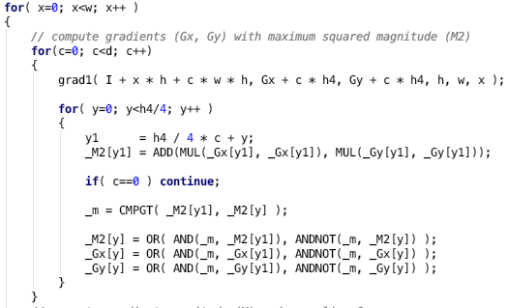
Gradient Calculations
nested for loops;
perfect for GPUs

Slide 22
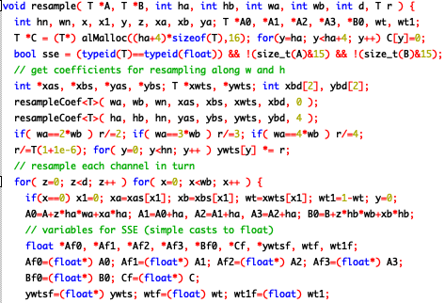
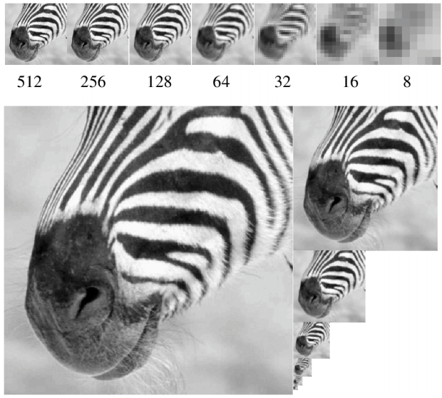
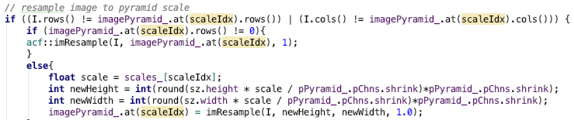
Image Pyramids
looped computations; embarrassingly parallel
order of magnitudes faster with GPU

Slide 23
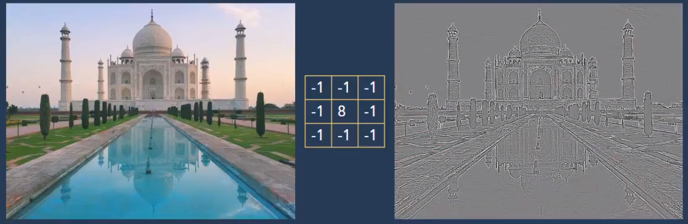
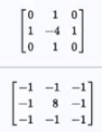
Edge Detection – remove neighbor color
Continuous areas -> grey
Discontinuities -> black & white lines

Slide 24
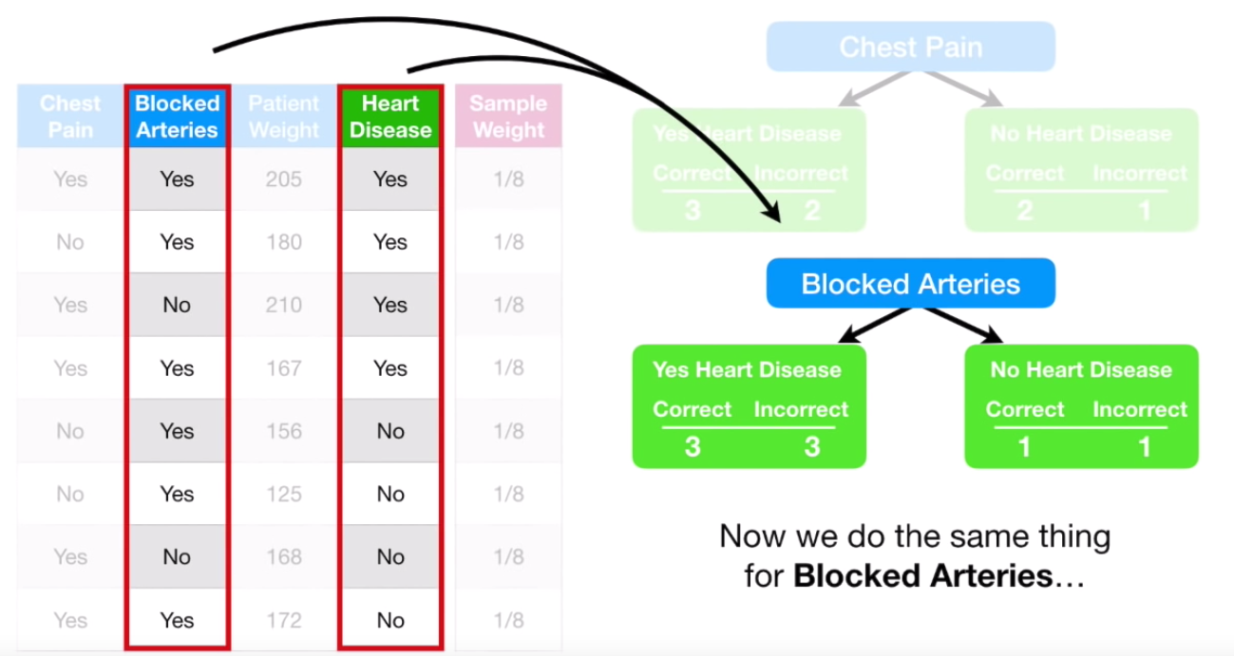
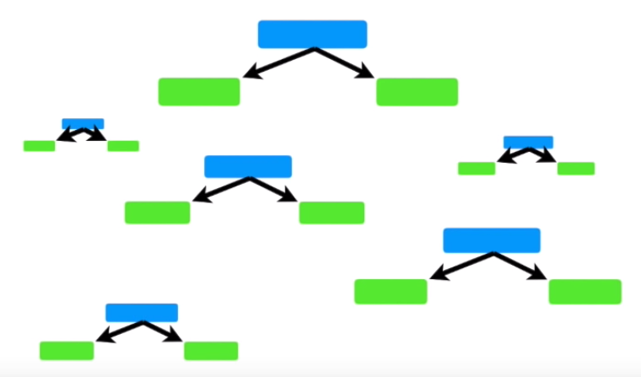
AdaBoost Ensemble Weighted Decision Trees
AdaBoost
Gradient Boosting
XGBoost
Notes:
https://www.youtube.com/watch?v=LsK-xG1cLYA

Slide 25
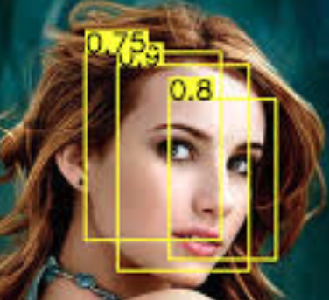
AdaBoost Ensemble Weighted Decision Trees
bounding boxes with probability

Slide 26
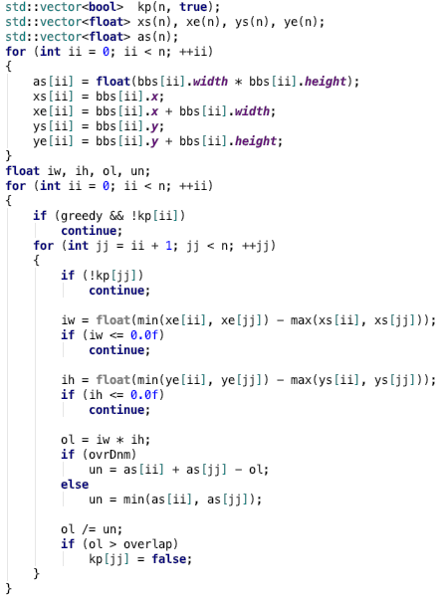
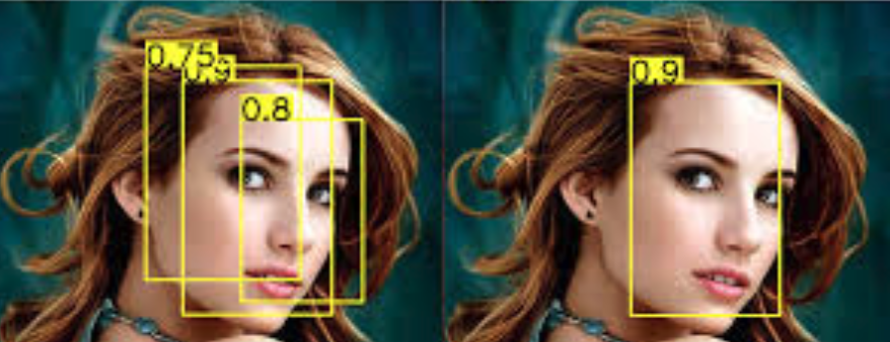
Non-Maximal Suppression
1. overlap?
intersect area / union area > 0.5 ?
2. if overlap, choose best score
nested for loop computations;
begging for GPU

Slide 27
Give me an ‘easy button’
Self-Service AI & Deep Learning

Slide 28
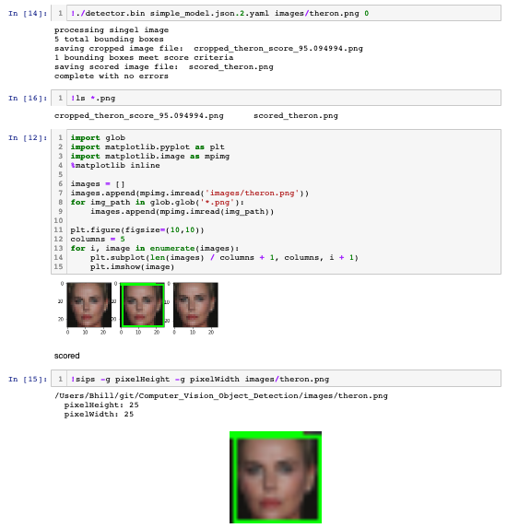
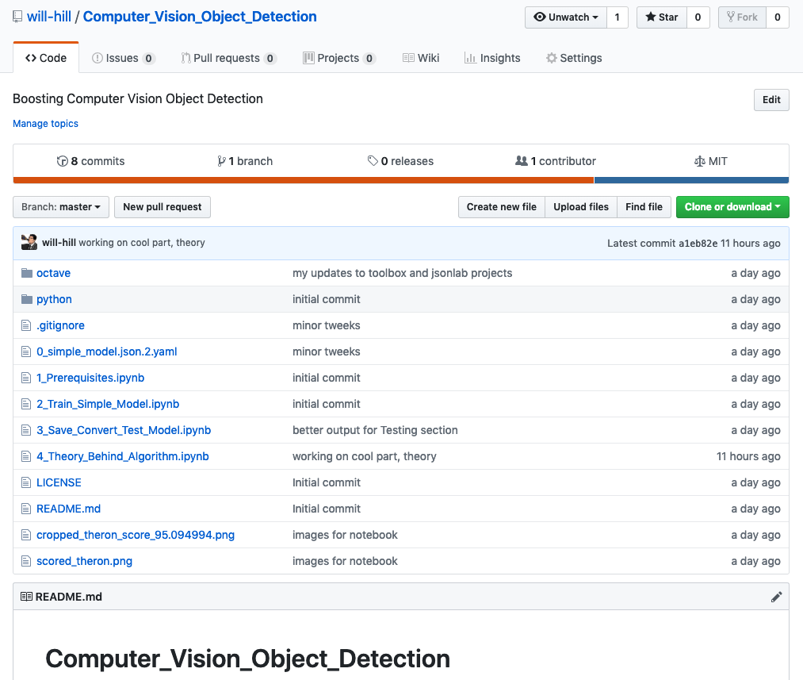
Jupyter Notebook Proof-of-Concept
Notes:
https://www.youtube.com/watch?v=LsK-xG1cLYA

Slide 29
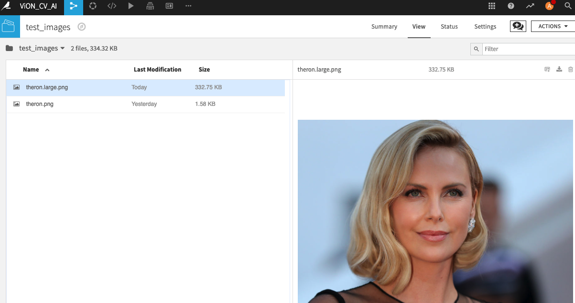
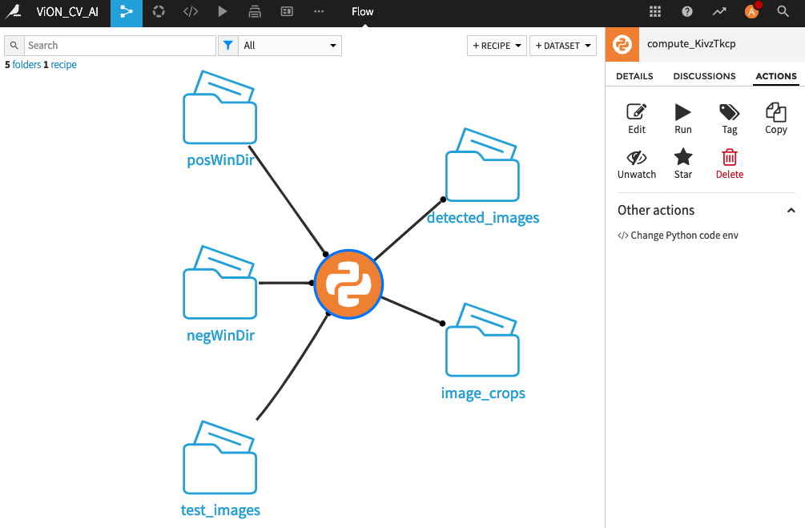
Easy Button Dataiku Plug-In
Notes:
https://www.youtube.com/watch?v=LsK-xG1cLYA

Slide 30
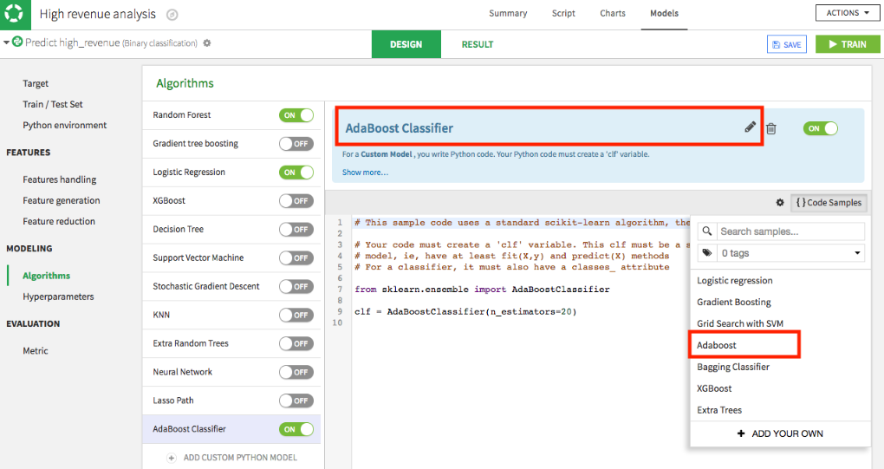
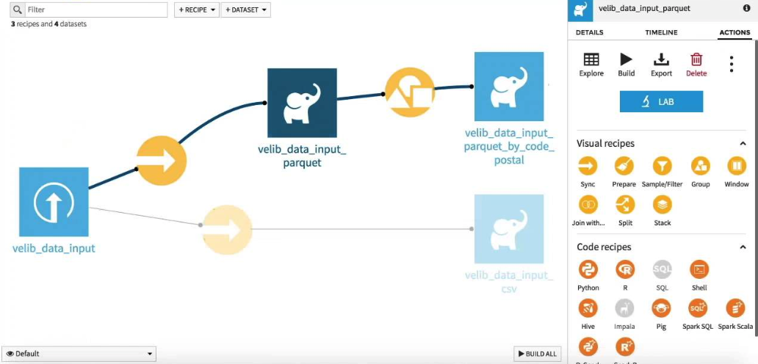
Click & Drag Modeling & Boosting

Slide 31
Questions? Me too.
Self-Service AI & Deep Learning

Slide 32
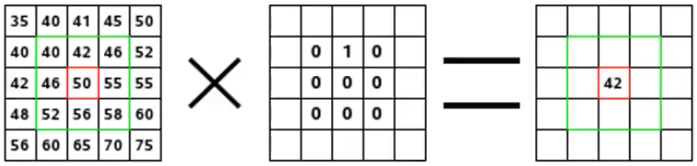
Convolution – kernel applied to pixels
weighted sum of pixels via kernel
images pixels
kernel
convolution

Slide 33

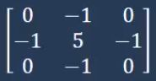
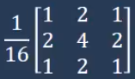
Common Kernels

Slide 34

Color Space
hsv
hue, saturation, value
separates luma, or the image intensity, from chroma or the color information
robustness to lighting changes or removing shadows
hsl – hue, saturation, lightness, similar to hsv
bgr
luv

Slide 35
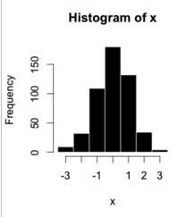
Histogram discretization | binning
bin
bin

Slide 36
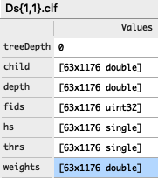
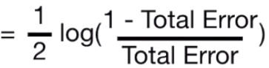
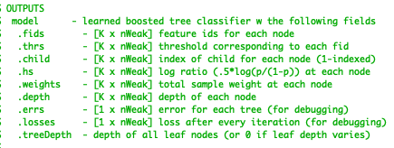
AdaBoost
treeDepth = 0 = variable tree depths
K = number of features
nWeak = number of trees
hs (coefficient)
ie, half log(”odds ratio”)
Classifier =
sum (coefficients[i] * prediction(trees[i], X)

Slide 37
Terms & Abbreviations
Pedestrian datasets: Caltech, INRIA, TUD-Brussels and ETH
PASCAL VOC
Image pyramid
natural image statistics
periodic textures
octave-space, octave and half-octave image pyramids, 42, 43
sparse image pyramids
channel features
aggregate feature channels (afc), 30 fps
integral channel features (icf)
striate cortical cells:wavelet expansion >>>> retinal ganglion cell:pixel
false positives per image (FPPI)
Viola and Jones (VJ), 10+ FFPI, 15 fps
Histogram of Oriented Gradients (HOG), 1 FPPI
more channels, finer scale sampling, enhanced normalization schemes
natural images have fractal statistics, 7, 33, 34
fast feature pyramids (ffp), ffp w/GPU, 100 fps
coarse-to-fine search [51], distance transforms [52]
sliding window paradigm 53, 27
Crosstalk cascades for frame-rate pedestrian detection
cascaded ensembles
image gradients
gradient histograms
gradient angles
Kernel – square matrix of spatial weights for pixels neighborhoods
deformable part models
crosstalk cascades , 35-65 fps, 40
branch and bound search
ROI – region of interest
NMS - Non-Maximal Suppression

